Slide 1
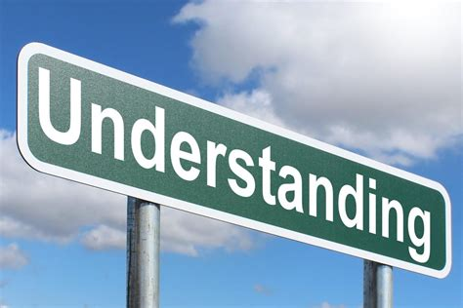
Understanding Iteration in Coding
Presenter: PopAi AI Creation

Slide 2

Content
1. The Concept of Iteration
2. Practical Applications of Iteration
3. Advantages and Best Practices of Iteration
4. Challenges and Considerations in Iteration

Slide 3

The Concept of Iteration
Section 1

Slide 4




Definition of Iteration
Repetition of Processes
Iteration in coding involves the repetition of a sequence of instructions or code until a specific condition is met.
Generating Sequences
It allows the generation of a sequence of outcomes through the repeated execution of a process.
Looping Constructs
Iteration is often achieved using looping constructs such as 'for' and 'while' loops in programming languages.
01
02
03

Slide 5
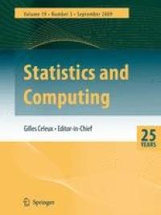

Importance of Iteration
Efficiency in Tasks
Iteration enables the automation of repetitive tasks, saving time and effort in coding.
Handling Large Datasets
It facilitates the processing of large datasets by performing the same operations on multiple data points.
Adaptability and Flexibility
Iteration allows for adaptable and flexible code that can handle varying inputs and conditions.

Slide 6
Types of Iteration
Count-Controlled Iteration
Involves executing a set of statements a specific number of times, often using a counter variable.
Condition-Controlled Iteration
Executes a set of statements as long as a specified condition is true, using constructs like 'while' loops.
Collection-Controlled Iteration
Involves iterating through a collection of items, such as arrays or lists, using constructs like 'for' loops.
01
02
03

Slide 7
Iteration vs. Recursion
Repetition of Processes
Both iteration and recursion involve the repetition of processes to achieve specific outcomes.
Stack Space Usage
Recursion may require additional stack space, while iteration typically does not, making it more memory-efficient.
Complexity and Readability
Iteration is often preferred for its simplicity and readability, especially for repetitive tasks in coding.
01
02
03

Slide 8

Practical Applications of Iteration
Section 2

Slide 9
Data Processing and Analysis
Data Validation
Iteration is used to validate and process large volumes of data, ensuring accuracy and consistency.
Data Transformation
It facilitates the transformation of data by applying the same operations to multiple data points.
Statistical Calculations
Iteration is essential for performing statistical calculations on datasets, such as mean, median, and standard deviation.
01
02
03

Slide 10
Algorithmic Problem Solving
Search and Sort Algorithms
Iteration is fundamental in implementing search and sort algorithms to process and organize data efficiently.
Pattern Matching
It enables the identification of patterns within data through repeated comparisons and evaluations.
Optimization Techniques
Iteration is employed in optimization algorithms to iteratively improve solutions until an optimal outcome is achieved.
01
02
03

Slide 11
User Interface Design
Event Handling
Iteration is used to handle user interactions and events within graphical user interfaces, such as processing mouse clicks or keyboard inputs.
Animation and Graphics
It facilitates the creation of animations and graphics by iteratively updating the display to create dynamic visual effects.
Input Validation
Iteration is employed to validate user inputs and provide feedback until valid input is received.
01
02
03

Slide 12
Iterative Development Process
Agile Methodologies
Iteration is a core principle in agile development, where software is developed incrementally through iterative cycles.
Feedback Integration
It allows for the integration of user feedback and continuous improvement throughout the development process.
Adaptation to Change
Iteration enables the adaptation to changing requirements and the incremental delivery of features in software development.
01
02
03

Slide 13
Advantages and Best Practices of Iteration
Section 3

Slide 14
Code Reusability and Modularity
Reusable Components
Iteration promotes the creation of reusable code components that can be applied across different parts of a program.
Modular Design
It encourages a modular design approach, where code is organized into smaller, manageable units for easier maintenance and updates.
Scalability
Iteration supports the scalability of code by allowing the reuse of existing logic in various contexts.
01
02
03

Slide 15
Error Detection and Handling
Error Identification
Iteration aids in identifying and handling errors by iteratively testing and validating code against different scenarios.
Exception Handling
It allows for the implementation of exception handling mechanisms to gracefully manage unexpected situations during program execution.
Debugging Support
Iteration assists in the debugging process by iteratively tracing and isolating issues within the code.
01
02
03

Slide 16
Continuous Improvement and Adaptation
Iterative Refinement
It enables the continuous refinement and enhancement of code through incremental updates and optimizations.
Adaptation to Requirements
Iteration supports the adaptation of code to changing requirements and evolving business needs.
Feedback Integration
It facilitates the integration of user feedback and stakeholder input to drive iterative improvements.
01
02
03

Slide 17
Collaborative Development Practices
Team Collaboration
Iteration fosters collaborative development practices by breaking down complex tasks into manageable iterations.
Agile Workflows
It aligns with agile methodologies, promoting iterative planning, development, and review cycles within development teams.
Continuous Integration
Iteration supports continuous integration and delivery practices, allowing for the seamless integration of code changes.
01
02
03

Slide 18
Challenges and Considerations in Iteration
Section 4

Slide 19
Performance Considerations
Optimizing Iterative Processes
Ensuring that iterative processes are optimized for efficiency and minimal resource consumption.
Complexity Management
Managing the complexity of iterative code to maintain readability and maintainability.
Resource Utilization
Balancing the trade-offs between resource utilization and the benefits of iterative approaches.
01
02
03

Slide 20
Iteration Control and Termination
Loop Termination
Ensuring that iterative loops have clear termination conditions to prevent infinite loops and program crashes.
Control Flow Management
Managing the control flow within iterative processes to handle different scenarios and edge cases effectively.
Error Handling
Implementing robust error handling mechanisms to address unexpected issues during iteration.
01
02
03

Slide 21
Iteration in Parallel and Distributed Systems
Concurrency and Parallelism
Considering the implications of iteration in parallel and distributed systems to ensure consistency and synchronization.
Data Integrity
Addressing data integrity challenges when multiple iterations operate concurrently on shared data resources.
Scalability and Performance
Optimizing iterative processes for scalability and performance in distributed computing environments.
01
02
03

Slide 22
Future Trends and Innovations in Iteration
Machine Learning and AI
Exploring the integration of iterative approaches in machine learning algorithms and artificial intelligence models.
Quantum Computing
Considering the impact of iteration in quantum computing and its potential for solving complex problems iteratively.
Iterative Automation
Leveraging iterative automation techniques for repetitive tasks in software development and data processing.
01
02
03

Slide 23

Thank You
Contact: popai@example.com

